Slide 1

Working with AutoIT in selenium-Part 2

Slide 2
Introduction
AutoIT is used to handle window based activity which are not handled by Selenium.
AutoIT uses a combination of mouse movement, keystrokes and window control manipulation to automate a task which is not possible by selenium webdriver.

Slide 3
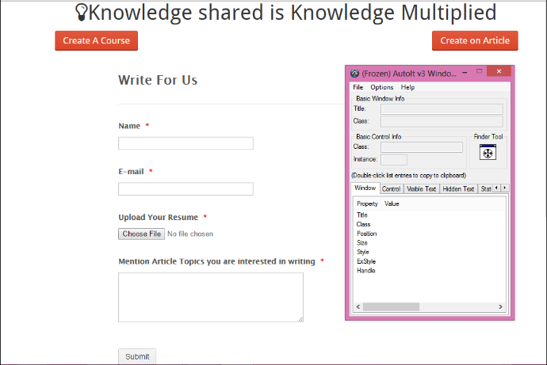
Find element through element Identifier and write script on AutoIT editor
Example :-upload resume
Step 1) open element Identifier- Go to 'C:\Program Files (x86)\AutoIt3' and click on 'Au3Info.exe' file, the element identifier window opens as shown in below screen.

Slide 4
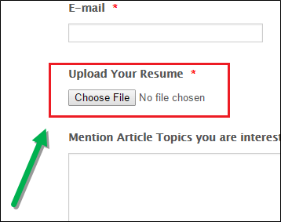
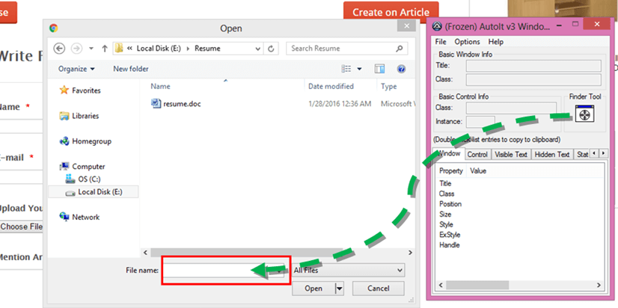
Step 2) open file uploader window by clicking on 'Choose File' which is windows activity.
Step 3) Drag the finder tool on the " File Name" box element of file uploader window to find the basic attributes info as shown in the below screen with the arrow.

Slide 5
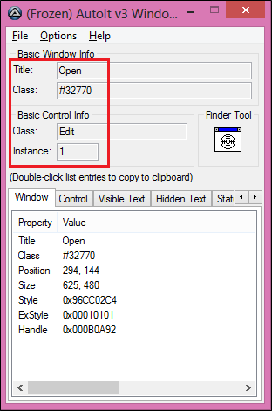
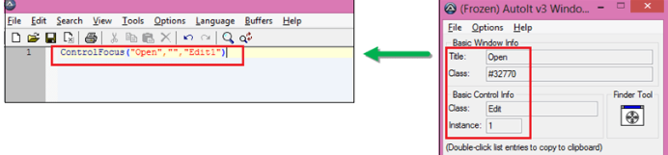
Get the value of attributes i.e. title='Open', class='Edit' and instance='1' as shown below. These values are used in writing AutoIT script.
Step 4) Open AutoIT script editor, goto 'C:\Program Files (x86)\AutoIt3\SciTE' and click on 'SciTE.exe‘.
Methods are required for writing file upload script are:-
ControlFocus(" title "," text ",controlID )is used for sets input focus to a given control on a window.

Slide 6
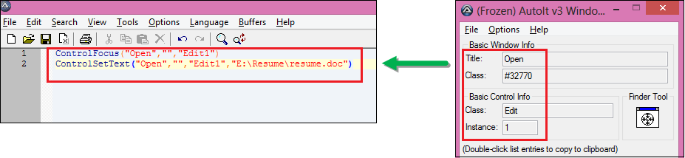
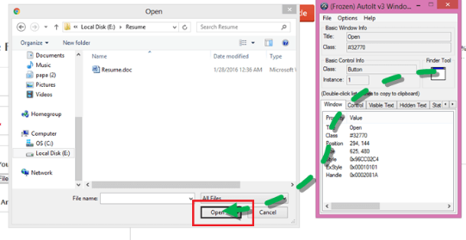
2) ControlSetText(" title "," text ",controlID ," File path which need to upload " ) is used for sets text of a control.
Step 5) Drag the finder tool on the "Open" button element of file uploader window to find the basic attribute information.

Slide 7
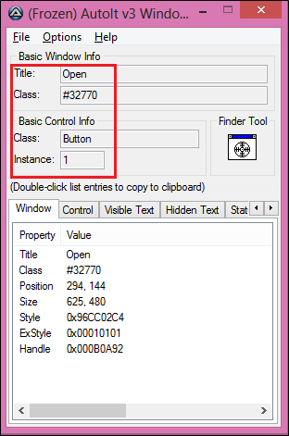
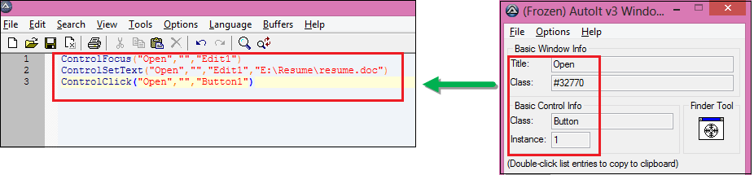
Get the value of attributes i.e. title='Open', class='Button' and instance='1' as shown below. These values are used in writing Autoit script
3) ControlClick(" title "," text ",controlID ) is used for sends a mouse click command to a given control.

Slide 8
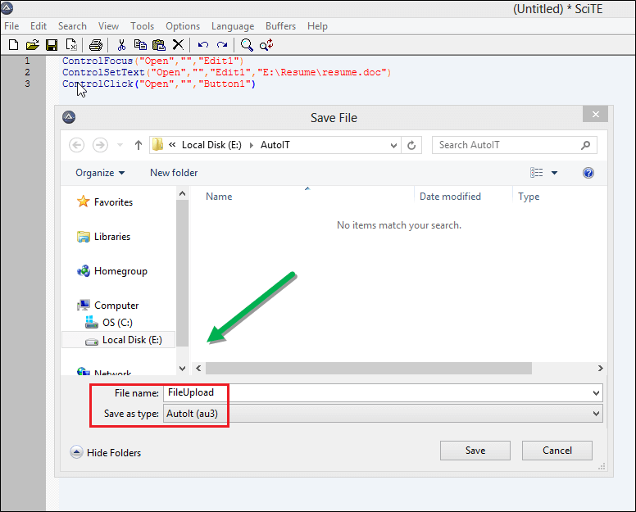
Step 6) AutoIT script is completed to handle file uploader.Now close the element identifier and save the script as " FileUpload " at the given location ( E:\AutoIT ).

Slide 9
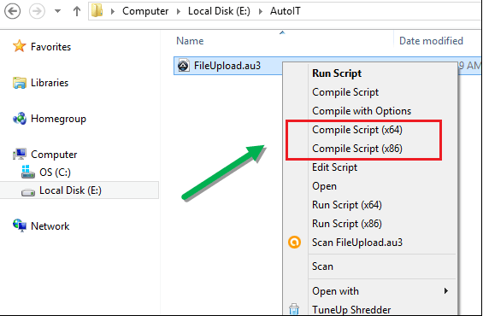
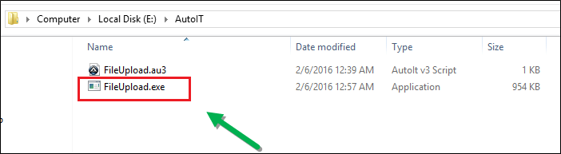
For compiling this script,two options " compile script x64 " and " compile script x86 ", if you have windows 32-bit machine then u go with " compile script x86 " and for windows 64-bit machine then u go with " compile script x64 .
Step 7) 'FileUpload exe' file generated after compilation,use this file in Selenium webdriver script.

Slide 10
AutoIT Upload file in Selenium Webdriver
Step 1): Develop selenium script in eclipse.
Runtime class allows the script to interface with the environment in which the script is running.
getRuntime() get the current runtime associated with this process.
exec() methods execute the AutoIT script ( FileUpload.exe ) .
Step 2) : Execute the Selenium script in Eclipse.
importjava.io.IOException;
import org.openqa.selenium.By;
import org.openqa.selenium.WebDriver;
import org.openqa.selenium.firefox.FirefoxDriver;
public class FileUpload {
public static void main(String[] args) throws IOException {
WebDriver driver=new FirefoxDriver();
driver.get(URL);

Slide 11
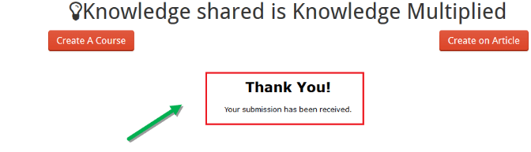
Step 3) Verify the output, resume.doc file uploaded successfully and thank you message will be displayed.
driver.findElement(By.id("postjob")).click();
driver.findElement(By.id("input_3")).sendKeys("Gaurav");
driver.findElement(By.id("id_4")).sendKeys("test.test@gmail.com");
driver.findElement(By.id("input_4")).click();
// below line execute the AutoIT script .
Runtime.getRuntime().exec("E:\\AutoIT\\FileUpload.exe");
driver.findElement(By.id("input_6")).sendKeys("AutoIT in Selenium");
driver.findElement(By.id("input_2")).click();
driver.close(); }
}

Slide 12
Covered Till Now
Element Identifier identifies the elements of file uploader window.
Prepared AutoIT script in the editor with the help of Element identifier.
Autoit script is used in selenium webdriver script.
Executed the selenium script.
Output: Successfully the file uploaded.

Slide 13
Thanks

